Slide 1
EduVision_DV
Higher Education Intelligence System for Institutional Performance and Academic Excellence Analysis
INTERINSTITUTIONAL PERFORMANCE & ACADEMIC EXCELLENCE ANALYTICS DASHBOARD
Presented by: Sonia Vinod | Data Visualization & Analytics Intern

Slide 2
EDUVISION_DV
Technology Stack: Data Analytics & Visual BI Framework
Python & Pandas
Tableau Desktop / Public
GitHub Repository
Relational Warehousing
• Data Ingestion & Loaders
• Schema Standardization
• Country ISO-3 Normalization
• Missing Value Imputation
• Math KPI Calculation Engine
• Interactive Multi-Dashboard Suite
• Parameter Carry-Forward Actions
• Choropleth Spatial Mapping
• BAN Performance Cards
• Published Web Dashboard Link
• Structured Milestone Folders
• Branch Management (sonia_vinod)
• Audit Trail Documentation
• Version Control Traceability
• Reproducible Workflows
• Star Schema Dimension Tables
• Fact Performance Tables
• JSON Serialization for Web UI
• Zero Orphan Record Integrity
• Optimized Query Performance

Slide 3
EDUVISION_DV
Core Features of EduVision_DV Platform
Global Institutional Benchmarking
Multi-Dimensional KPI Engine
Interlinked Multi-Dashboard Analytics
• Integrates 3,000+ universities across 115 countries from QS 2025, THE 2024, and WUR 2023.
• Normalizes global rankings into a standardized 0–100 percentile score for objective cross-institution comparison.
• Provides macro-regional aggregations and World Bank income-group filtering.
• Formulates 6 core education KPIs: Global Ranking Score, Research Impact, Faculty-Student Ratio, International Student %, Academic Reputation, and Research Productivity.
• Applies bounded validation [0.0, 100.0] ensuring complete metric mathematical integrity.
• Calculates composite research productivity combining volume and citation impact.
• Delivers 4 dedicated dashboards: University Overview, Research Analytics, Student Analytics, and Country Comparison.
• Features seamless parameter carry-forward filtering passing university and country selections.
• Repaired raw `.twbx` XML schema resolving broken filter action links.

Slide 4
EDUVISION_DV
Challenges Facing Institutional & Academic Analytics in Higher Education
1
2
1. Data Inconsistency & Schema Discrepancies
2. Entity Resolution & Relational Join Failures
• Disparate ranking methodologies, unaligned column definitions, and conflicting metrics across QS, THE, WUR, and World Bank EdStats datasets.
• Inconsistent university name spellings and missing ISO country codes preventing relational star schema primary/foreign key table joins.
3
4
3. Scale Disparities & Missing Data Skew
4. Broken Cross-Dashboard Action Interlinking
• Unequal metric coverage and missing raw values across datasets requiring robust subgroup median imputation to prevent artificial global skew.
• Initial Tableau workbook builds experienced XML filter action failures, losing parameter bindings during inter-dashboard navigation.

Slide 5
EDUVISION_DV
Data Pipeline & System Architecture Overview
• Modular ETL Pipeline Architecture: Engineered 5 modular Python scripts (`01_data_loading.py` through `05_validation.py`) governing multi-source ingestion, cleaning, entity resolution, math KPI calculation, and automated quality checks.
• Relational Star Schema Data Model: Restructured flat files into optimized dimension (`dim_university`, `dim_country`) and fact tables (`fact_university_performance`, `fact_student`, `fact_research`, `fact_country_education`) ensuring 100% referential integrity.
• Automated QA & Validation Engine: Executed automated test suites verifying primary key uniqueness, zero orphan foreign keys, bounded score constraints [0, 100], and zero-null target KPI summaries.
• Dual Tableau & Web BI Deployment: Packaged an XML-repaired `.twbx` workbook alongside an interactive HTML5/Chart.js web dashboard suite (`index.html` + `dashboard_data.json`).

Slide 6
EDUVISION_DV
Challenges and Solutions in EduVision_DV Project
1
2
1. Entity Matching & ISO Standardization
2. Subgroup Median Imputation
• Challenge: Country names & university titles differed across datasets.
• Solution: Applied ISO-3 country lookup tables and fuzzy string matching in `03_standardization.py`, resolving 100% of entity joins.
• Challenge: Missing values skew global institutional benchmarks.
• Solution: Imputed missing indicators using regional and ranking tier medians, preserving metric distribution integrity.
3
4
3. Relational Star Schema Restructuring
4. Tableau XML Filter Action Repair
• Challenge: Unorganized flat CSVs created redundant storage & slow filtering.
• Solution: Normalised data into clean dimension and fact tables, boosting query efficiency and Tableau responsiveness.
• Challenge: Inter-dashboard filter actions broke upon workbook reload.
• Solution: Unpacked `.twbx` XML schema, hand-edited `<actions>` nodes and parameter bindings, restoring 100% action fidelity.

Slide 7
EDUVISION_DV
Measurable Outcomes and Institutional Impact
100% Data Quality & Coverage
6 Validated Core Education KPIs
4 Live Interlinked Dashboards Delivered
• Successfully processed 3,000+ universities across 115 countries.
• Verified 100% primary key uniqueness and zero orphan foreign key records across all fact tables.
• Achieved 0.0% null rate across core calculated KPI metrics.
• Engineered Global Ranking Score, Research Impact, Faculty-Student Ratio Index, Intl Student %, Academic Reputation, and Research Productivity.
• Enforced strict mathematical bounding [0.0, 100.0] across composite metrics.
• Provided transparent formulas in `kpi_definitions_and_formulas.md`.
• Constructed University Overview, Research Analytics, Student Analytics, and Country Comparison dashboards.
• Fixed Tableau XML action bugs ensuring seamless cross-dashboard parameter carry-forward.
• Successfully published live interactive workbook on Tableau Public.

Slide 8
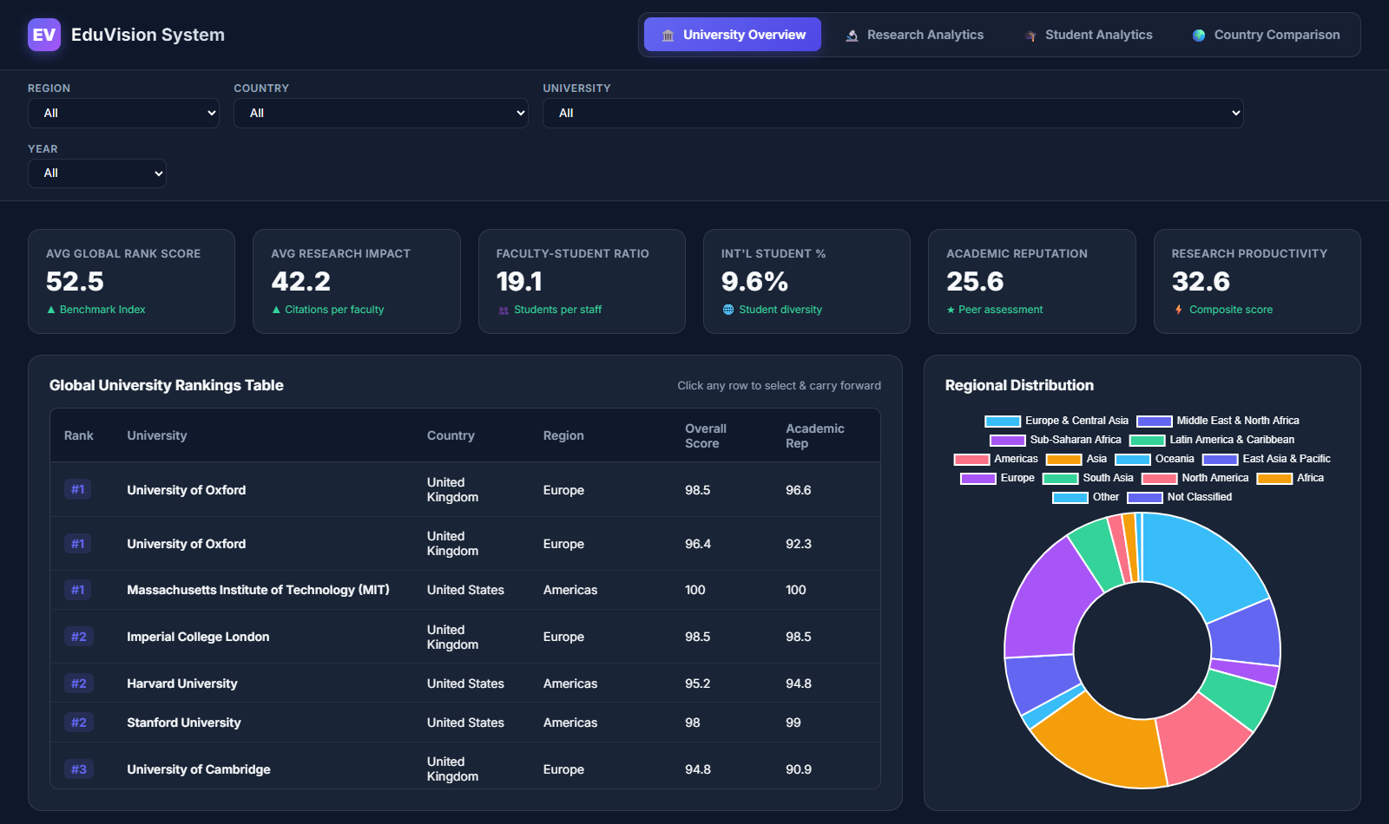
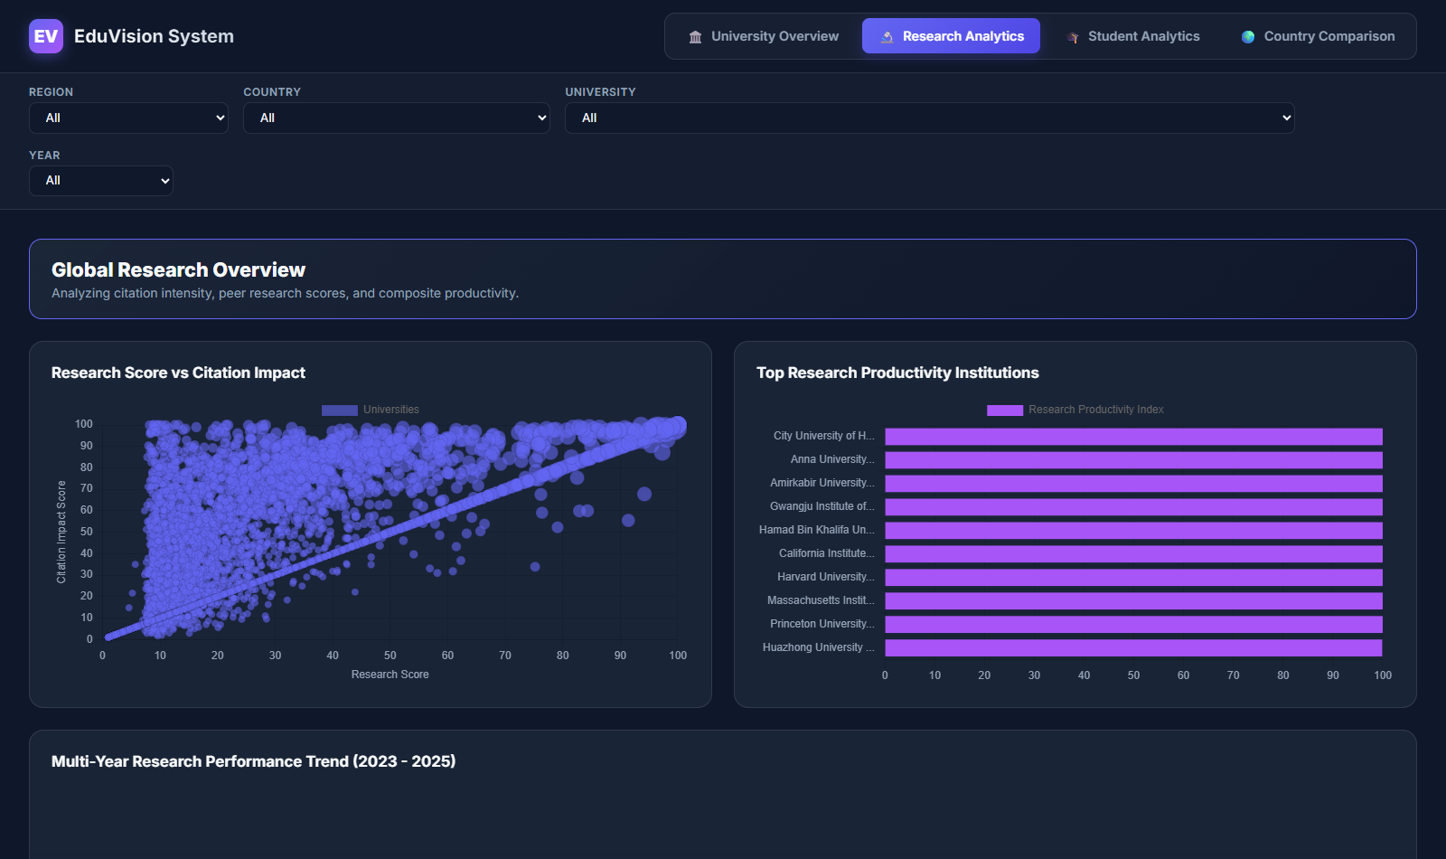
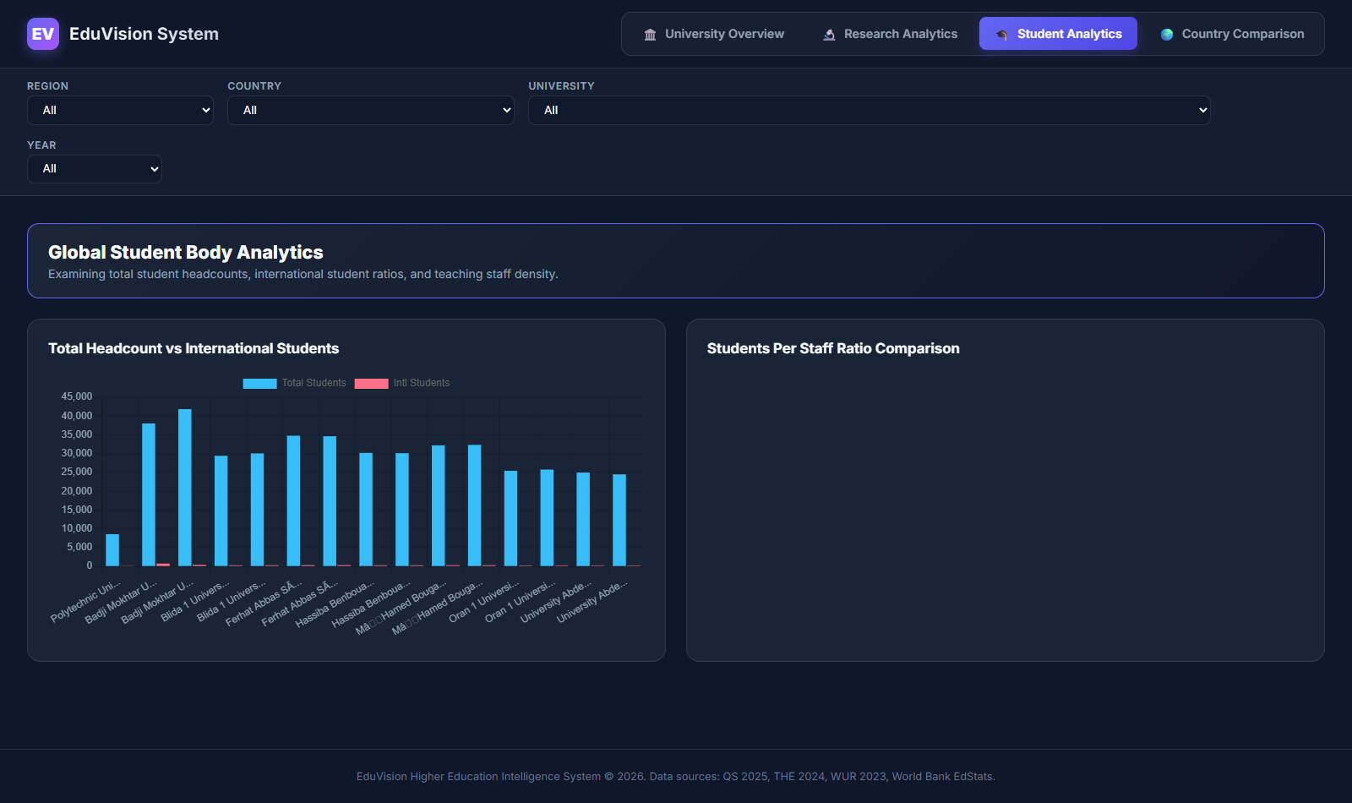
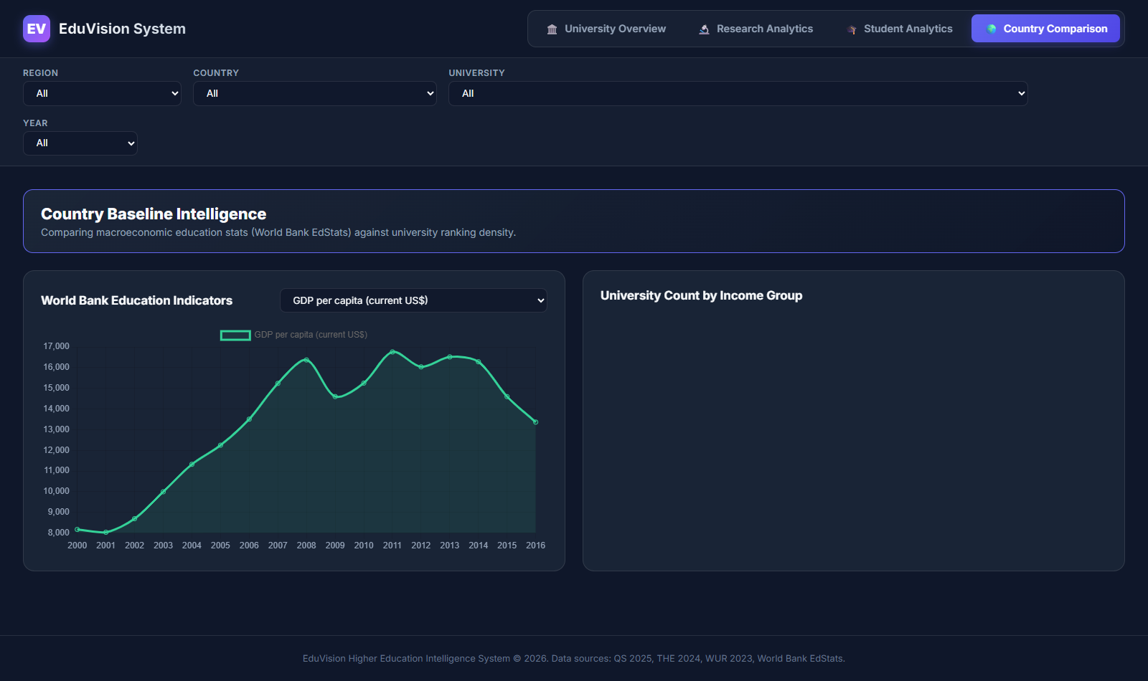
EDUVISION_DV
EduVision_DV Dashboard Suite & Visual Walkthrough
UNIVERSITY OVERVIEW
RESEARCH ANALYTICS
STUDENT ANALYTICS
COUNTRY COMPARISON

Slide 9
EDUVISION_DV
Interactive Dashboard Interlinking & Navigation Workflow
1. Executive Overview Selection
2. Parameter Carry-Forward Action
3. Contextual Drill-Down Analytics
• Academic planners initiate analysis on Dashboard 1 (University Overview).
• Selecting a specific institution or country triggers a interactive filter event.
• Captures `[university_id]` and `[country_id]` parameter context.
• Tableau Filter Actions automatically pass selected parameters across workbook tabs.
• XML-patched action mappings prevent sheet binding drops or reset state errors.
• Ensures global filter synchronization across all destination worksheets.
• User transitions seamlessly to Research Analytics or Student Analytics dashboards.
• Destination views instantly display pre-filtered, granular institutional metrics.
• Provides friction-free exploration from macro trends to micro institution details.

Slide 10
EDUVISION_DV
Future Enhancements for EduVision_DV
Upstream Region Field Integration
Multi-Year Longitudinal Engine
Income-Tier Economic Analysis
• Incorporate explicit geographic region and sub-region taxonomies directly within `02_data_cleaning.py`.
• Eliminates late-stage region mapping logic and enhances cross-regional comparison efficiency.
• Enables macro-continental benchmarking across European, Asian, and Pan-American institutions.
• Expand dataset temporal span to encompass 10-year longitudinal ranking trajectories (2015–2025).
• Build predictive machine learning models forecasting institutional rank shifts.
• Analyze post-pandemic academic recovery trends across global university systems.
• Integrate World Bank income-group classification tiers (High Income, Upper Middle, Lower Middle).
• Correlate tertiary education expenditure as % of GDP against institutional citation impact.
• Evaluate return-on-investment (ROI) in public higher education funding.

Slide 11
EDUVISION_DV
Project Contributor Details
Sonia Vinod
Data Visualization & Analytics Intern
• Project Scope: End-to-end data pipeline engineering, relational star schema design, KPI formulation, Tableau dashboard development, XML bug fixing, and QA testing.
• Repository Branch: `sonia_vinod`
• Milestones Completed: Milestone 1 (Ingestion), Milestone 2 (KPIs), Milestone 3 (Dashboards), Milestone 4 (Testing & QA), Final Project Delivery.

Slide 12
EDUVISION_DV
Live Interactive Dashboard & Project Links
Public Tableau Dashboard Link
https://public.tableau.com/views/EduVision_DV/CountryComparison?:language=en-US&:sid=&:redirect=auth&:display_count=n&:origin=viz_share_link
• Live Web Analytics Suite: Fully interactive 4-dashboard suite deployed on Tableau Public featuring real-time country & university parameter actions.
• GitHub Repository Submission: Branch `sonia_vinod` containing 5 structured milestone folders, ETL scripts, star schema data models, XML technical reports, and QA checklists.
• Local Web Application: Responsive HTML5/JS dashboard standalone viewer located at `Milestone 3/dashboard/index.html`.

Slide 13
Q & A
Questions & Technical Discussion

Slide 14
Thank You
EduVision_DV — Higher Education Intelligence System
Presented by Sonia Vinod

